Slide 1

HEALTH SYSTEM Manages clients and health services Presented by: Keith Gitobu Gitonga Software Development Intern Project

Slide 2
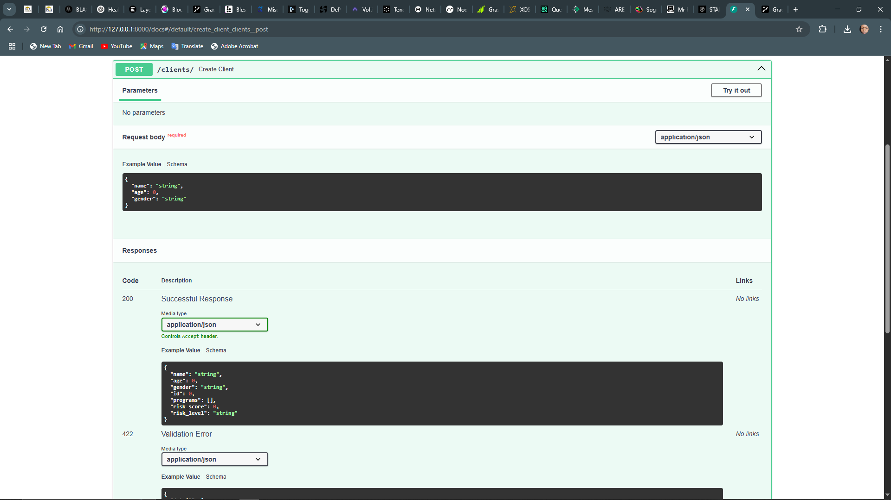
OVERVIEW
A simple program that stimulates basic health information for managing clients and health programs, It is built with FastAPI and SQLite to help allows doctors to create health programs (e.g., TB, HIV), enable client registration and program enrollment, search and view client profiles and display client data securely via API.
GitHub - https://github.com/whoistobu/health system.git
Dependencies - pip install fastapi uvicorn sqlalchemy
Run – uvicorn main: app

Slide 3
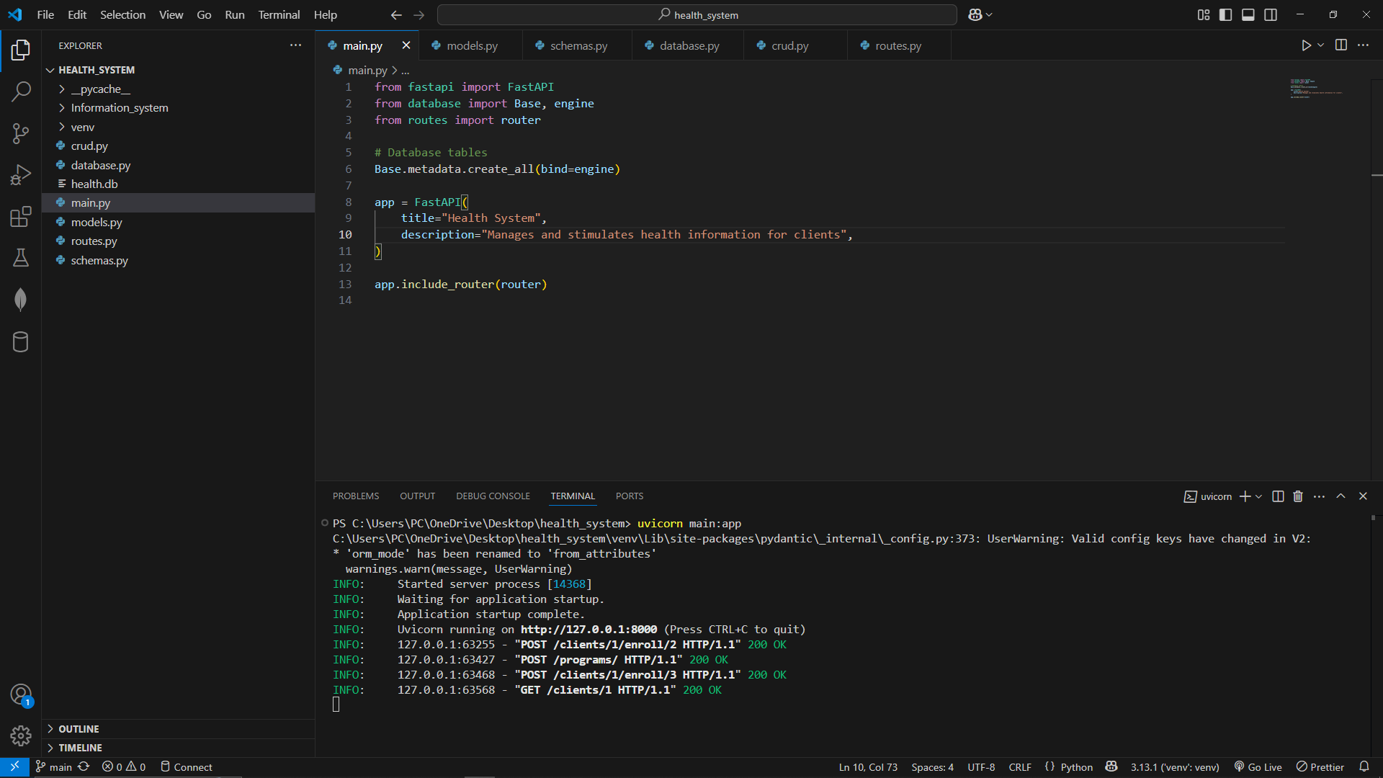
Approach, Design, Innovations & Solution
Approach
API design with FastAPI
SQLite + SQLAlchemy for lightweight persistence
Pydantic schemas for automatic validation & serialization
Modular structure:
database.py(DB setup)
models.py (ORM classes)
schemas.py (Pydantic models)
crud.py (data operations)
routes.py (HTTP endpoints)

Slide 4
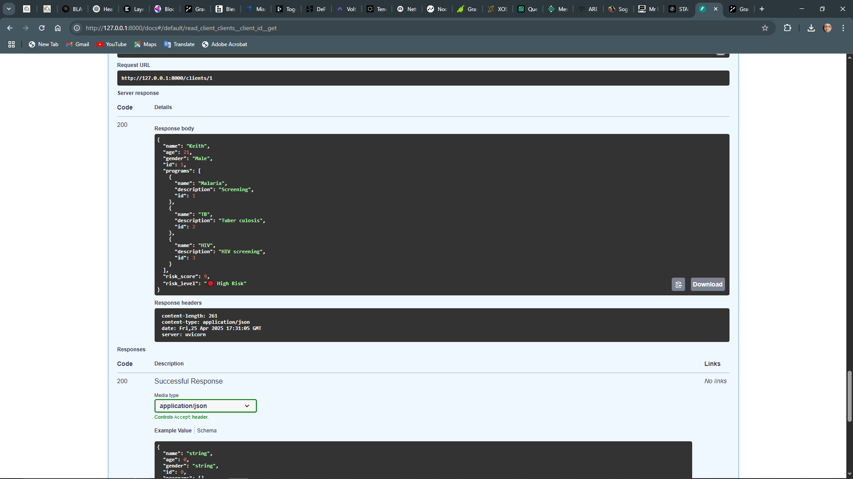
2. Design
Clear separation of concerns by file
Many-to-many between clients & programs via an association table
Schemas define request vs. response payloads
CRUD layer encapsulates all DB logic
Routes inject DB sessions via dependency injection

Slide 5
3. Innovation
Rule based health risk scoring (age, gender, enrolled programs)
Intuitive risk levels: 🟢 Low, 🟡 Moderate, 🔴 High
Duplicate-name checks with clear 400 errors

Slide 6
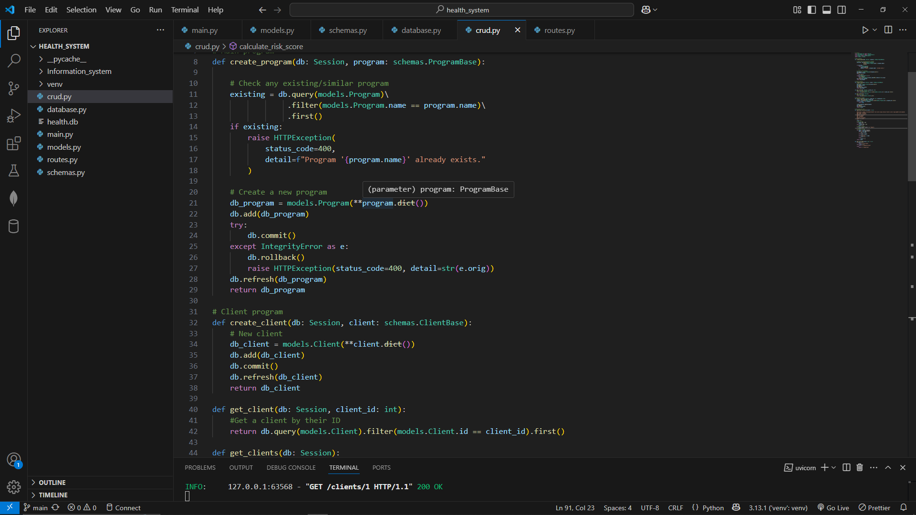
Solutions
API Endpoints (Solution)
POST /programs/ → create health programs
GET /programs/ → (optional) list programs
POST /clients/ → register clients
GET /clients/ → list clients with risk score & risk_level
GET /clients/{id} → detailed profile + risks
POST /clients/{id}/enroll/{pid} → enroll in programs
Error Handling & Validation
Duplicate program names → 400 with clear message
Pydantic validation → 422 on bad input, 404 when client/program not found , 500 avoided by wrapping DB commits in try/except

Slide 7
PROTOTYPE DEMONSTRATION
Start your server - uvicorn main: app
Open your browser to http://127.0.0.1:8000/docs
Create a program e.g. { "name": "TB", "description": "Tuberculosis screening" } and Click Execute.
Register a client e.g. { "name": "Alice", "age":65, "gender": "Female" } and Click Execute
Enroll the client e.g. fill the field as shown below client_id=1, program_id=1 then execute
View the profile - Fill client_id=1 and execute. You should see "programs": [...], "risk_score": 6, "risk_level": "🟡 Moderate Risk"

Slide 8

Thank You.

